Slide 1
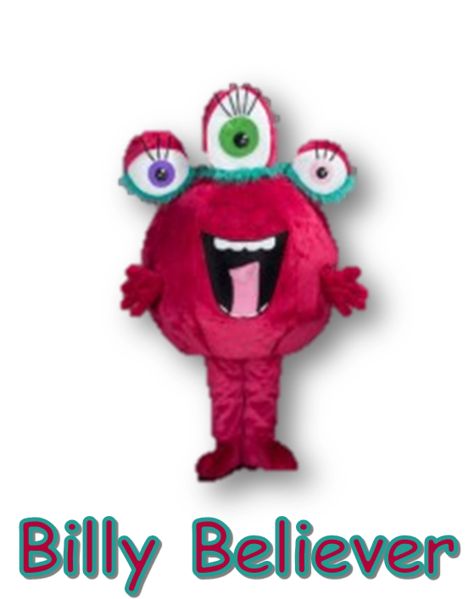
Dreamers, Believers, Achievers
Believe in yourself.
You are braver than you think, more talented than you know and capable of more than you imagine.

